Slide 1
Procedure for Download Contract Note From Our website www.Nirmanbroking.com

Slide 2
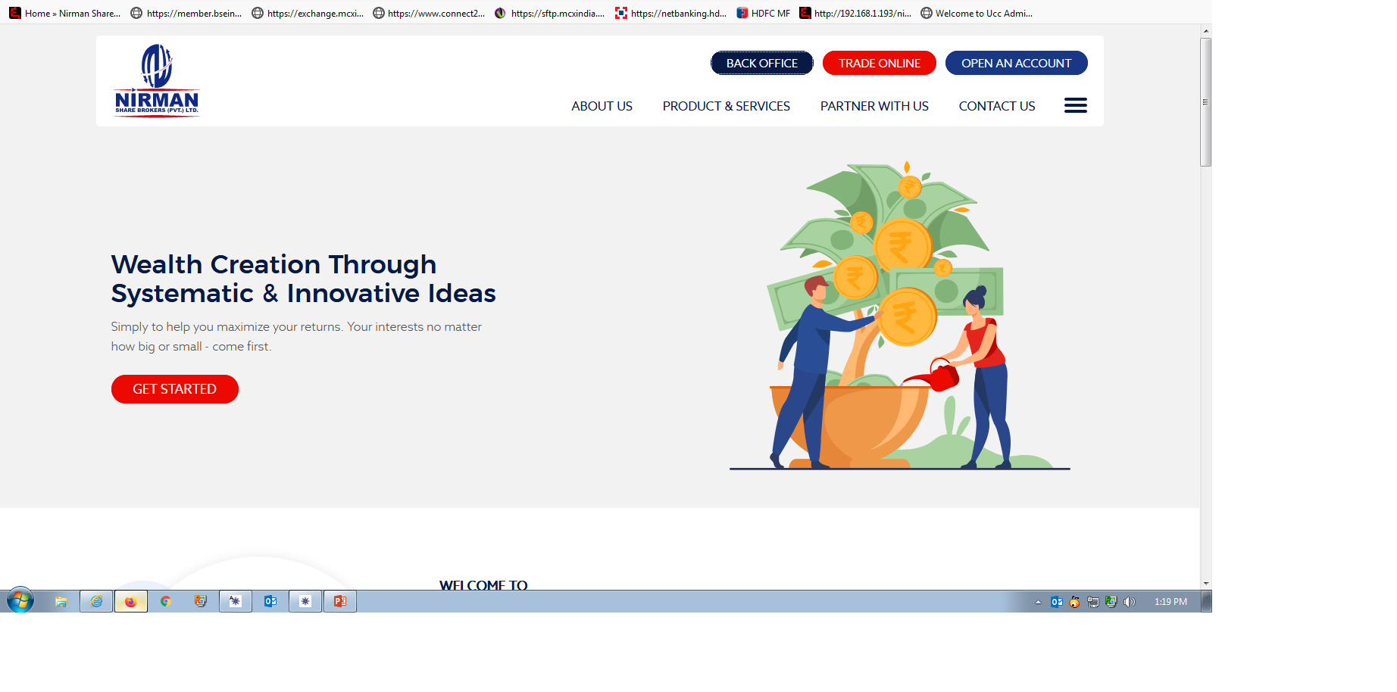
Click Here

Slide 3
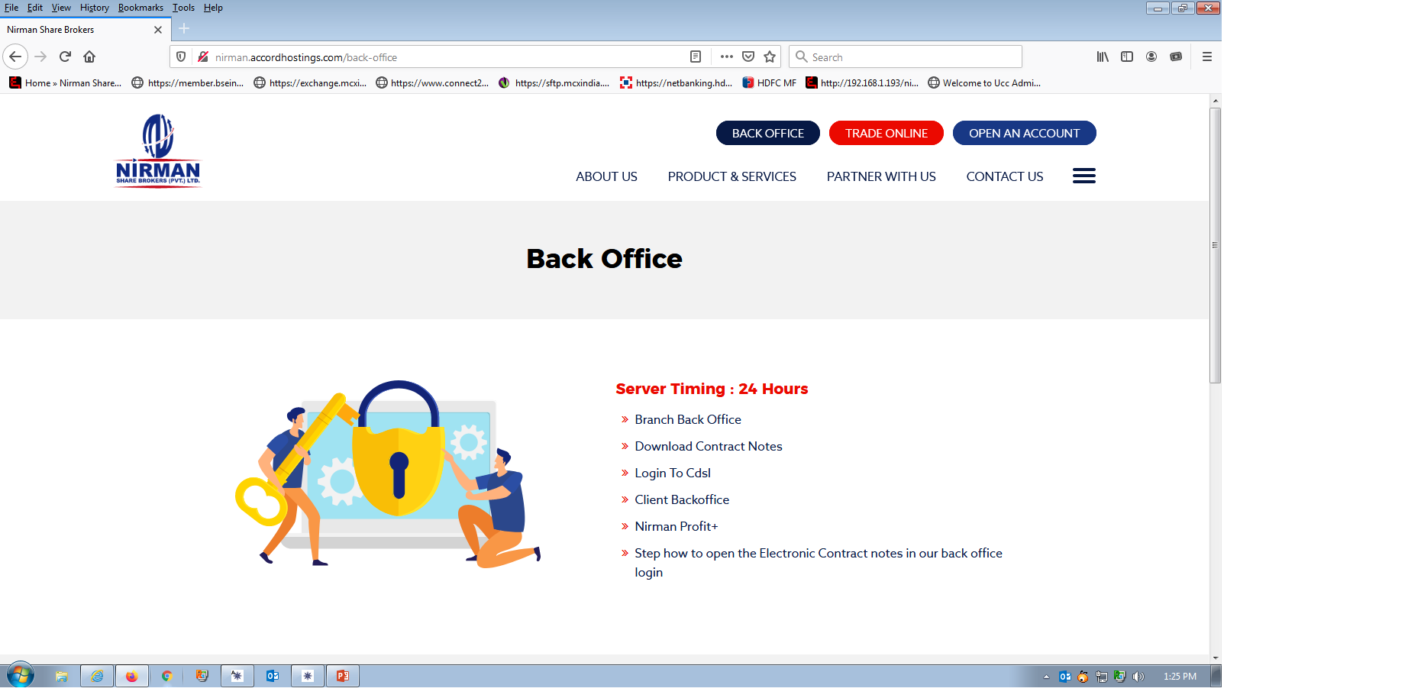
Open Client Backoffice
Click Here

Slide 4
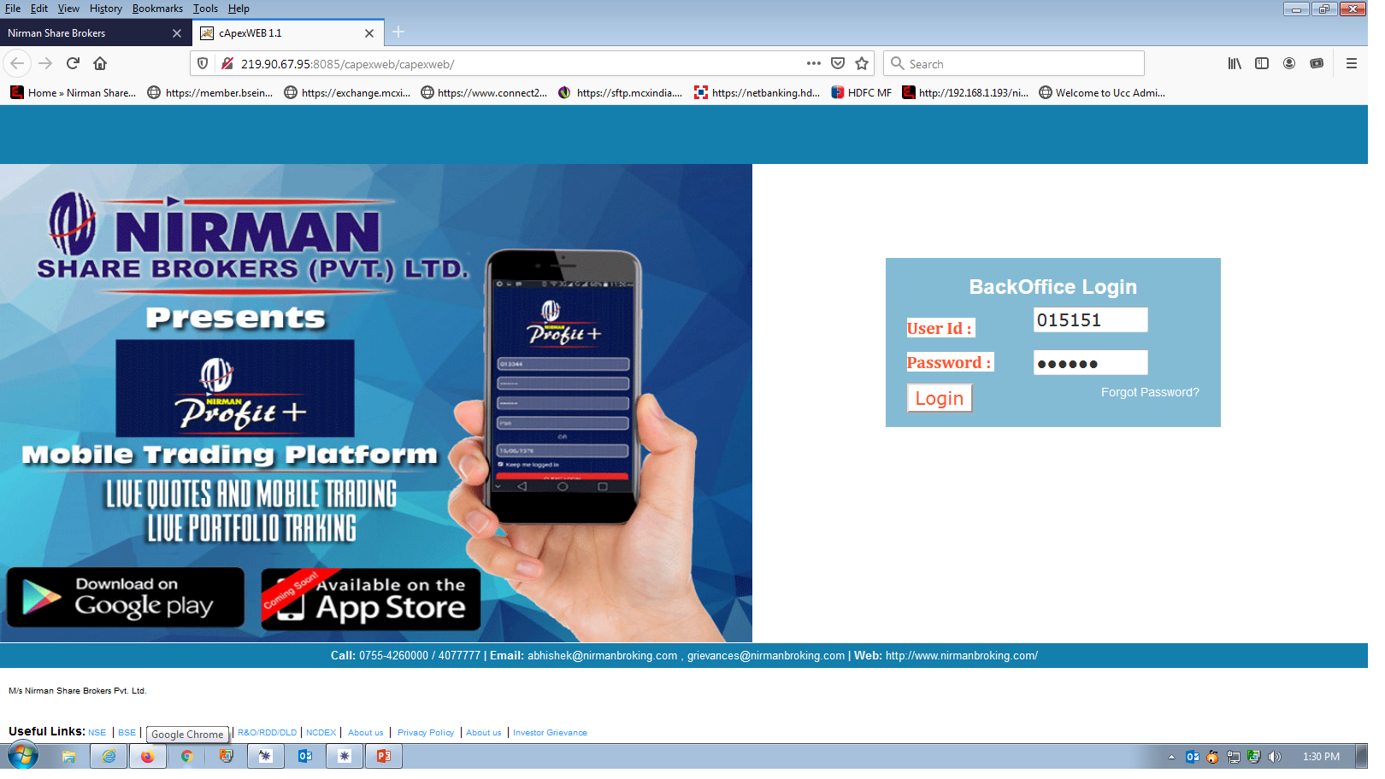
Back-office Login
Trading code and Password

Slide 5
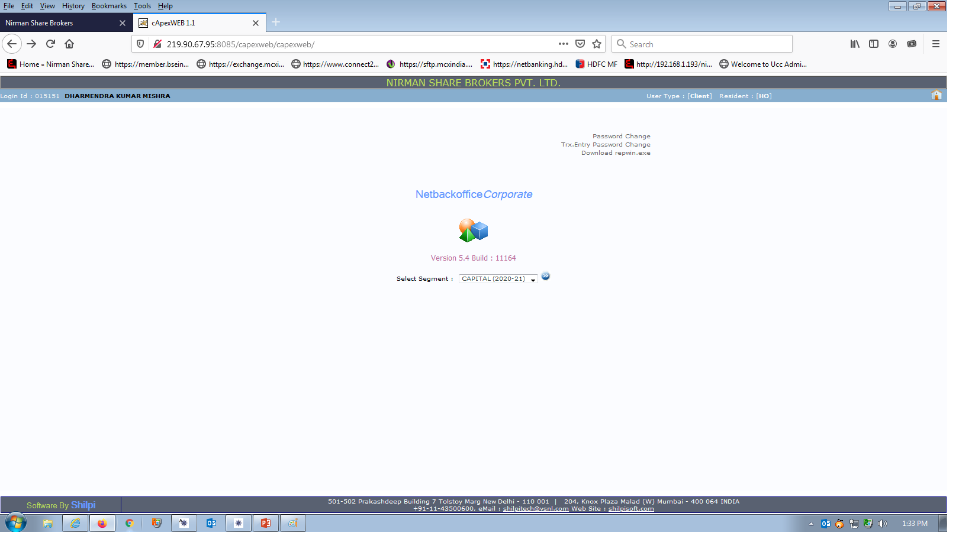
Select your option for Download Contract notes
Click here

Slide 6
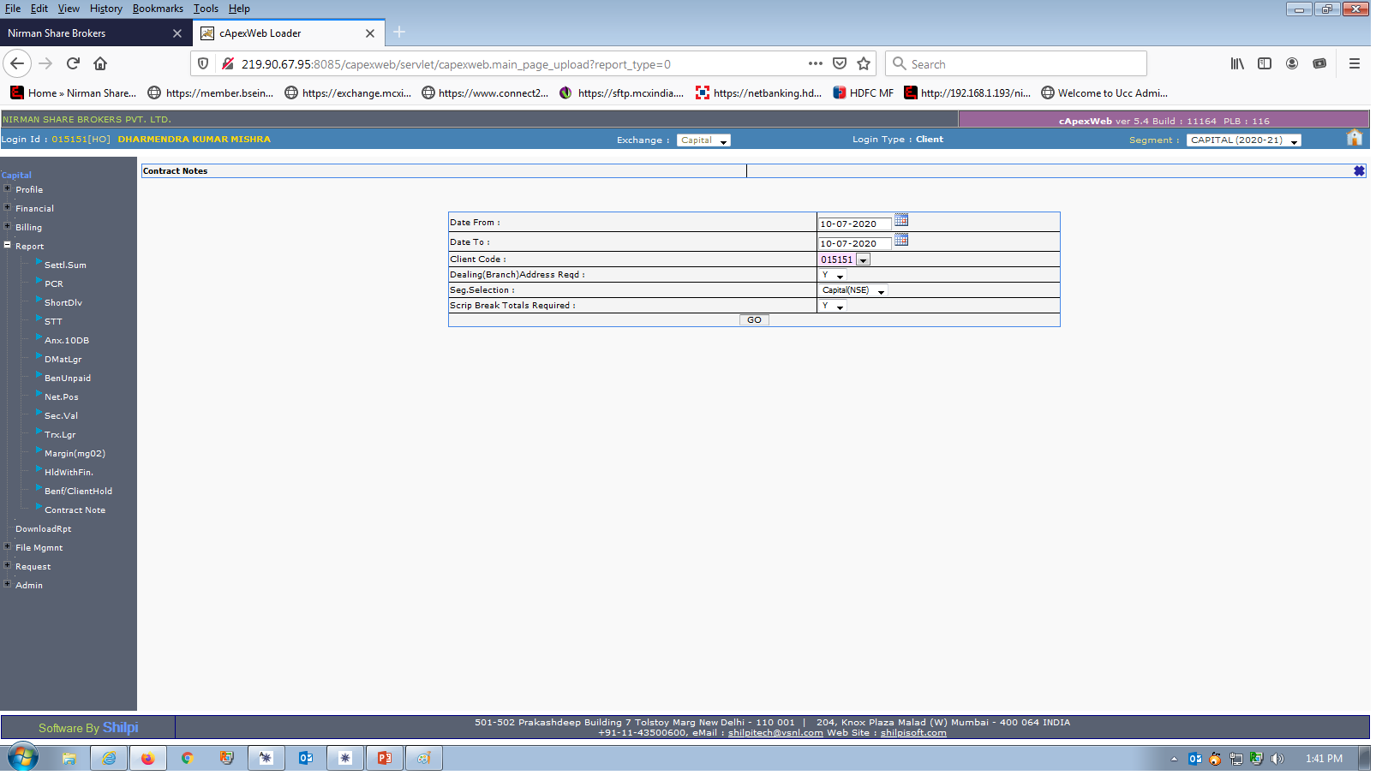
Please Select the given options and download/view.
Select Dates and click on GO
Click on Contract Note

Slide 7
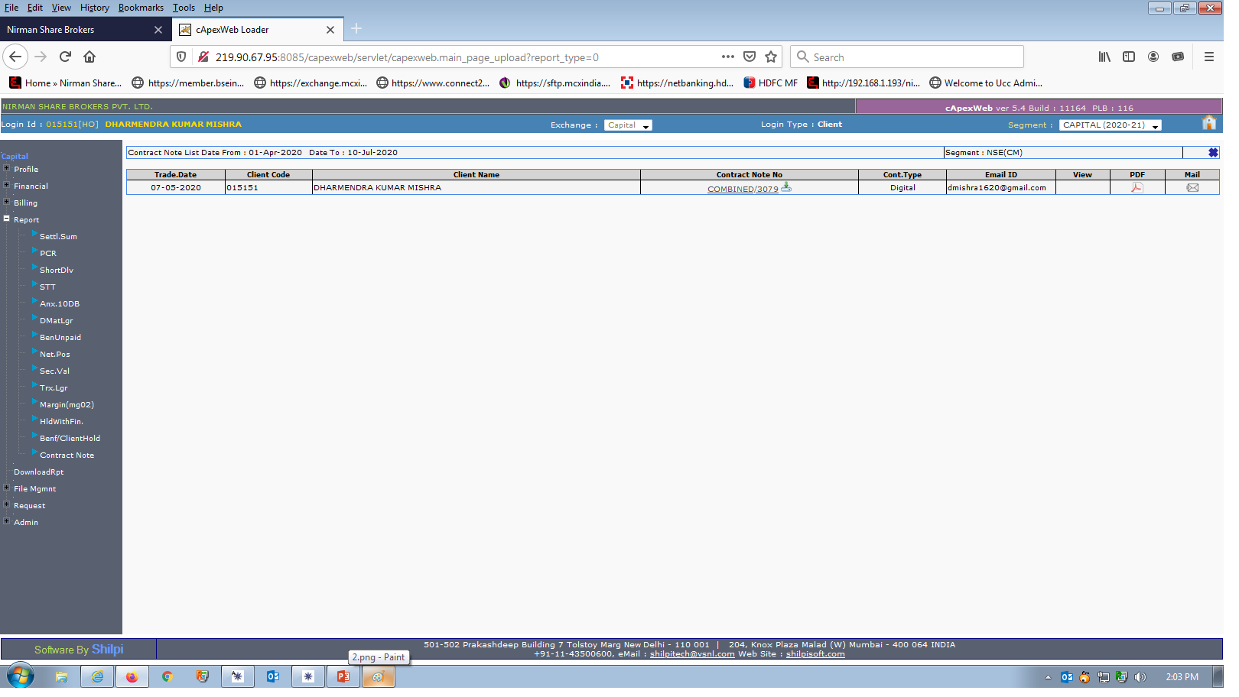
Date wise contract note showing
Click of Down Arrow for view or download your ECN

Slide 8
Nirman House, 8 Zone-1, M.P. Nagar Bhopal 462011 (M.P.) Ph:- 0755-4260000, Web: www.nirmanbroking.com Email :- Info@nirmanbroking.com

